Slide 1
Introduction to Accelerator Physics Spring 2018 Review for Midterm
Todd Satogata (Jefferson Lab and ODU) / satogata@jlab.org
http://www.toddsatogata.net/2018-ODU-AP

Slide 2
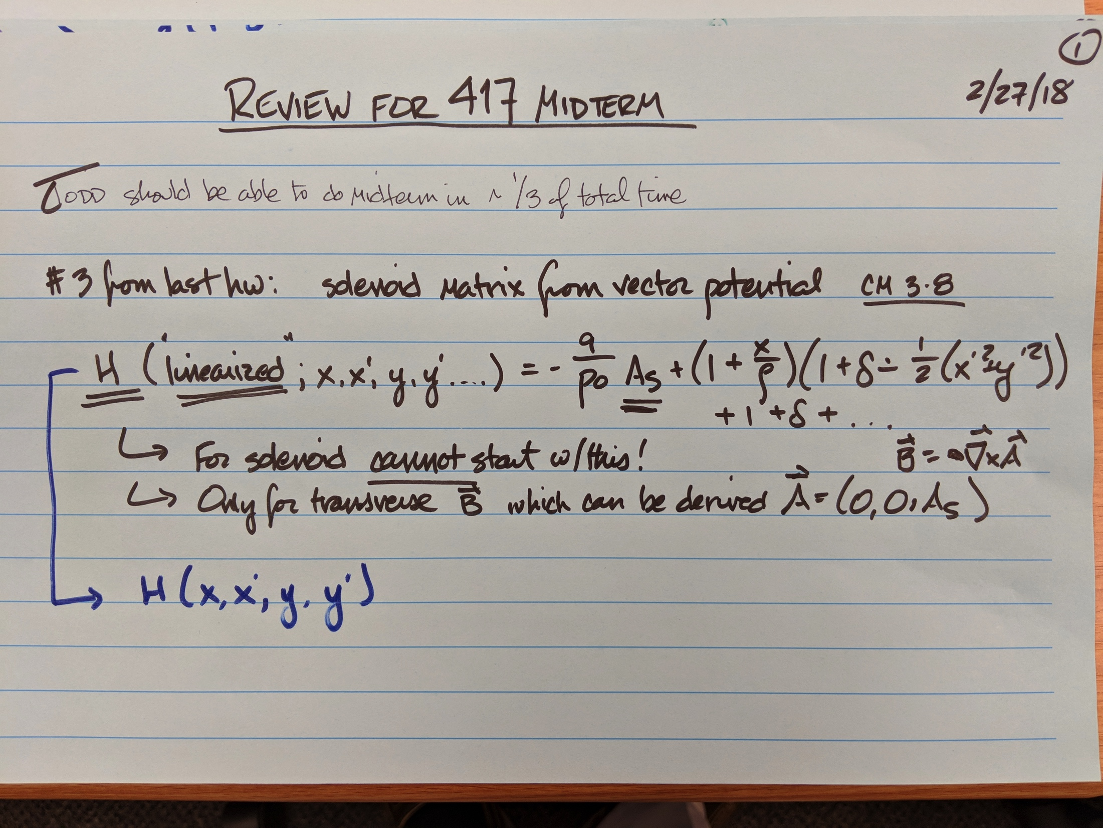

Slide 3
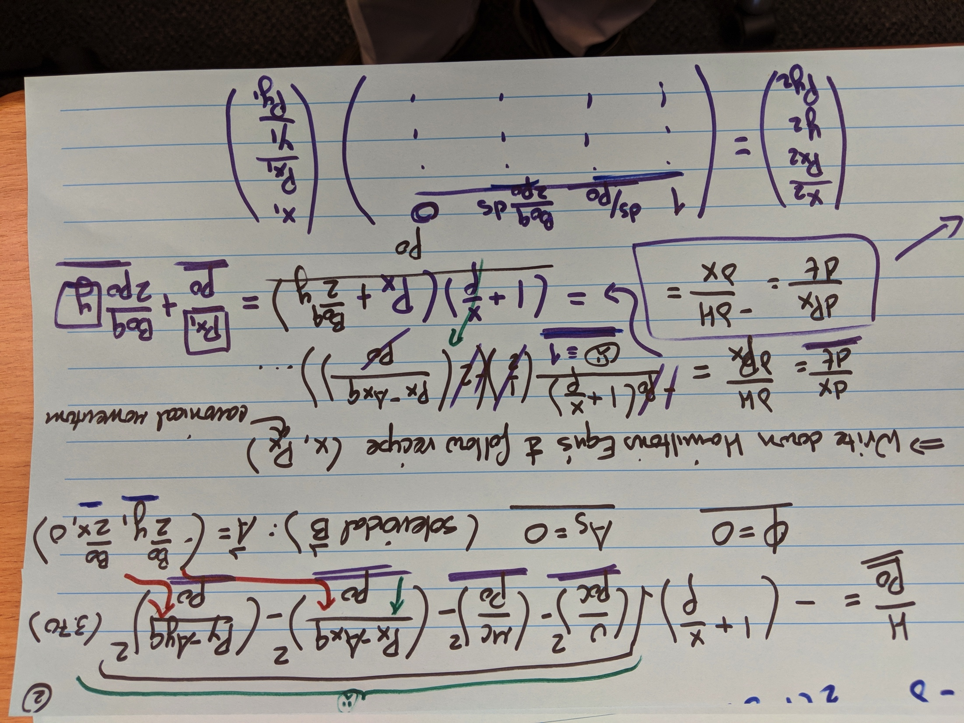

Slide 4
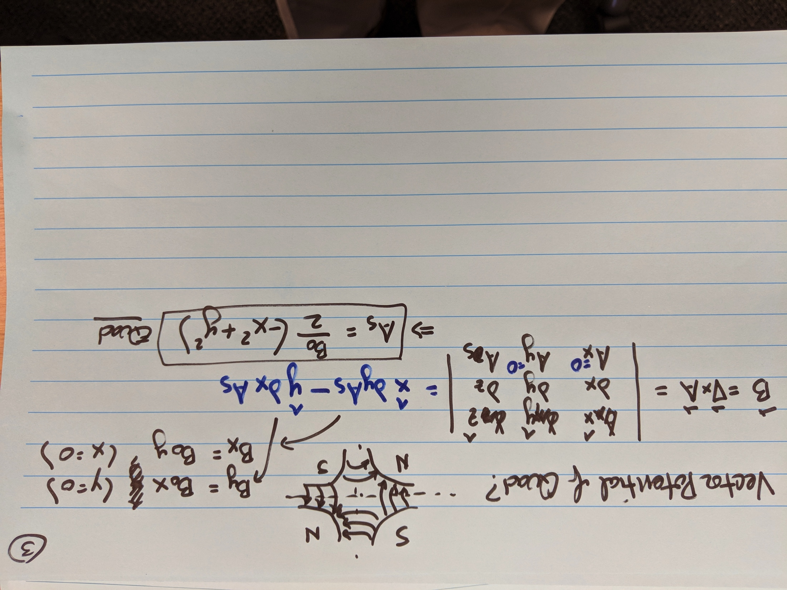

Slide 5
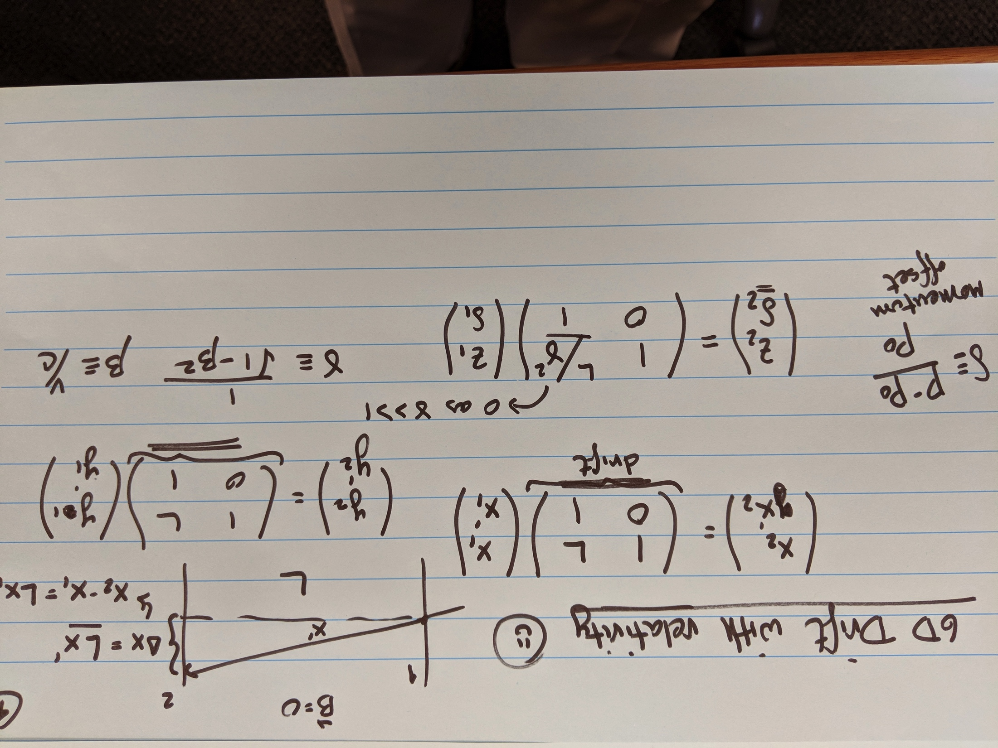

Slide 6
